Slide 1


Hashing Files

Slide 2

What is Hashing?
A hash is sort of like the numbers on a barcode on the back of a product, but for entire files that may be very large in size. A hash function takes an input (or 'message') and returns a fixed-size alphanumeric string. The process by which this is done is called a hashing algorithm.
This output string is usually a 16/32/64 character code called the 'hash value', 'message digest', 'digital fingerprint', 'digest' or 'checksum'. This is essentially a summary of the file or message in question. Like a signature!
The best hashing algorithms are designed so that it's impossible to turn a hash back into its original string.
Notes:
Photo Credit: https://pics.me.me/the-slash-bringing-hasher-you-mean-youve-never-heard-the-sto-22203407.png
Fun intro video for 1 minute Hashing
https://www.youtube.com/watch?v=b4b8ktEV4Bg

Slide 3
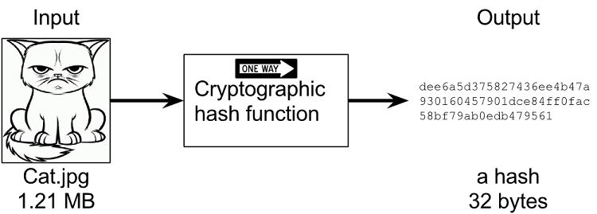

Slide 4
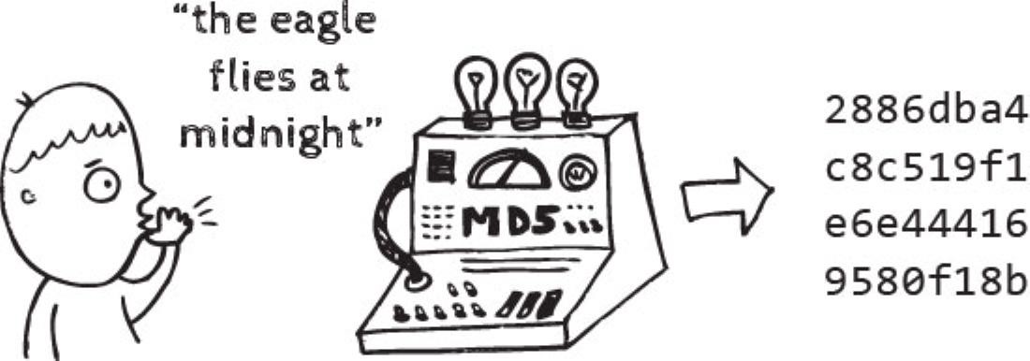

Slide 5
Three Main Requirements of (an ideal) hash:
Speed: a hashing algorithm should be reasonably fast, but not to quick. If it’s to quick, it is easy to crack or duplicate (more on this in the next slide).
The Avalanche Effect: if the file or message is question is changed in ANY way, the entire hash should be changed COMPLETELY.
Avoiding Hash Collisions: having two documents or messages with the same hash- **The Pigeonhole Principle**

Slide 6

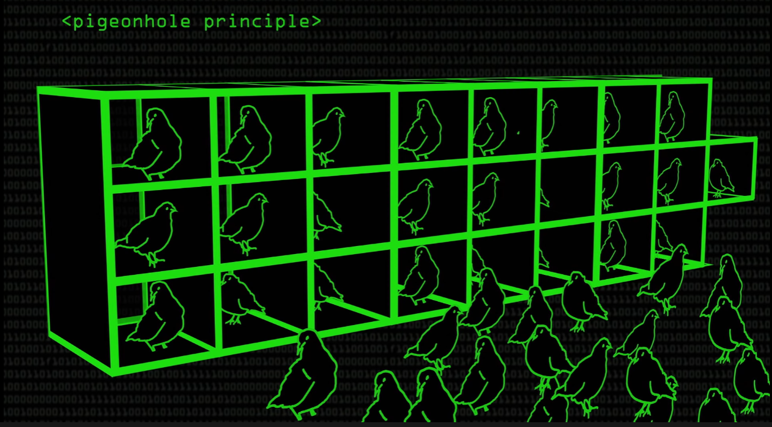
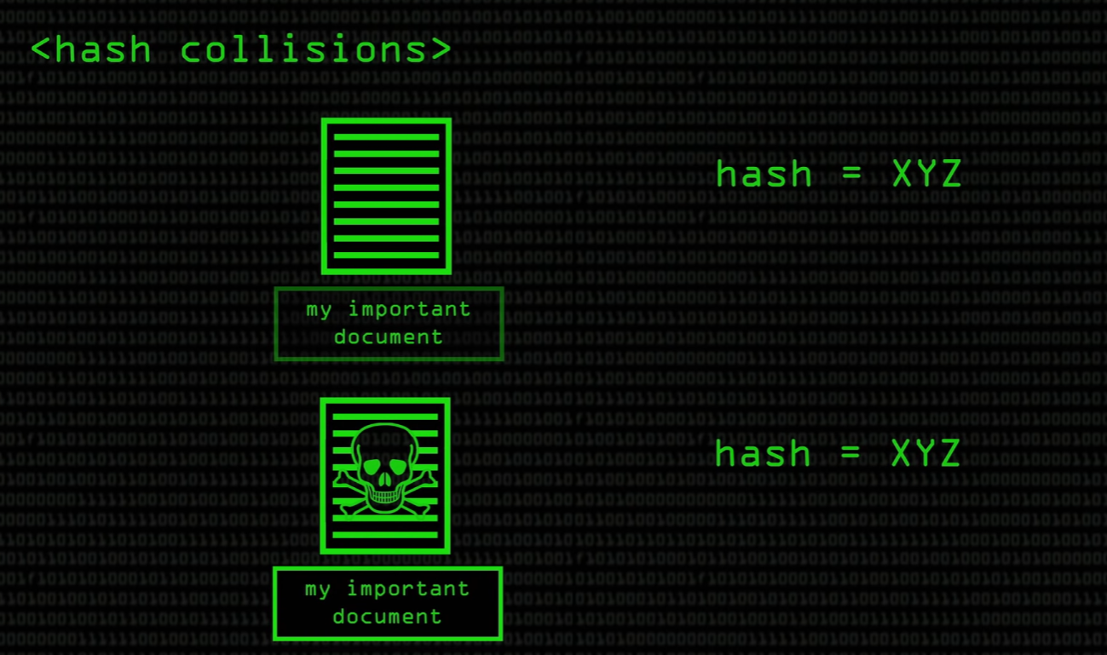
The Pigeonhole Principle explained
If you have 50 pigeons and only 25 pigeonholes, each hole would have to hold 2 pigeons. The same thing happens with files. There millions if not billions of files in circulation, so it is bound that two files may have the same hash value. This is okay if it happens naturally, but if it done artificially, this is a big security issue.

Slide 7
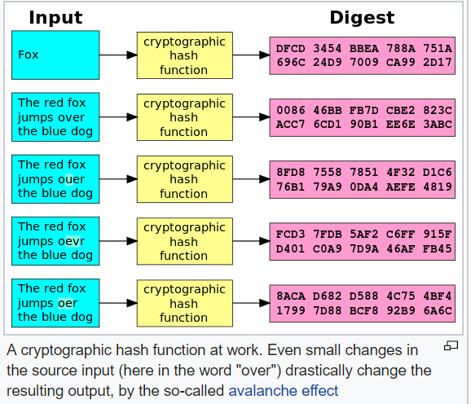

Slide 8
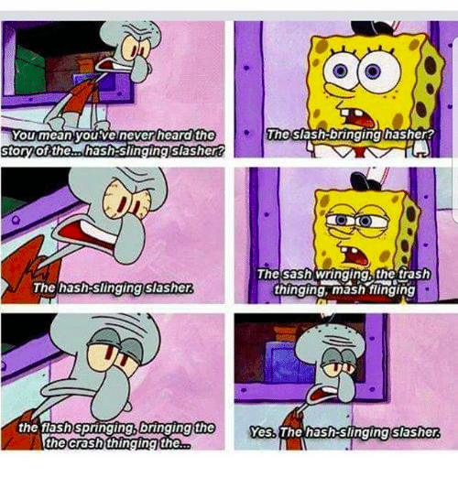
Types of Hashing
MD5: 128 bit hash, can have many vulnerabilities
SHA-1: 160 bit hash, much more secure than MD5
SHA-2: a family of different hash values, much more secure than SHA-1 and MD5

Slide 9
MD5
The MD5 (Message Digest 5) algorithm is a widely used hash function producing a 128-bit hash value.
Although MD5 was initially designed to be used as a hash function, it can be cracked by brute-force attack and suffers from extensive vulnerabilities.
Look up ‘MD5 hash cracker’ on Google, and crack the below hash. Tomorrow we will be using the terminal to crack MD5 hashes!
MD5: 7cf2db5ec261a0fa27a502d3196a6f60
Notes:
Message Digest

Slide 10
SHA-1
SHA-1 (Secure Hash Algorithm 1) is a hash function designed by the National Security Agency and is a U.S. Federal Information Processing Standard published by the National Institute of Standards and Technology.
SHA-1 is no longer considered secure. In 2005, cryptanalysts found attacks on SHA-1 suggesting that the algorithm might not be secure enough for ongoing use.
Using the same hash cracking you found, crack the below hash and tell me what you get. We will be cracking SHA-1 hashes as well!
SHA1: 4b7f913d75e033b86ee32430bb42fa9566f90356
Notes:
Secure Hash Algorithm 1

Slide 11
SHA-2
SHA-2 improves on SHA-1 in every possible way by containing a family of various hashes varying in complexity and size. SHA-2 contains SHA-224, SHA-256, SHA-384, SHA-512, SHA-512/224, SHA-512/256, at sizes of 224 bits, 256 bits, 384 bits or 512 bits respectfully.
While SHA-2 is much more secure and is still commonly used in the industry today, in 2015, SHA-3 was designed as a back-up in case the SHA-2 family was cracked. Common words that are encrypted using a hashing algorithm from the SHA-2 family are easily broken, however. Try this one below:
SHA-256: f223faa96f22916294922b171a2696d868fd1f9129302eb41a45b2a2ea2ebbfd

Slide 12
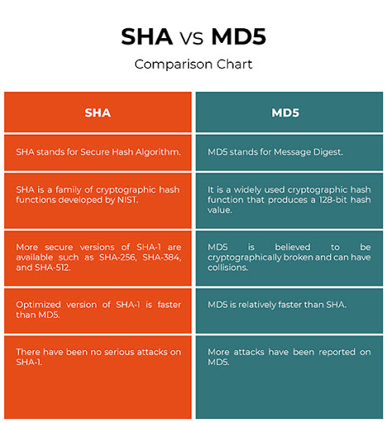
SHA Vs MD5
Notes:
Nist-national institute of standards and technology.

Slide 13
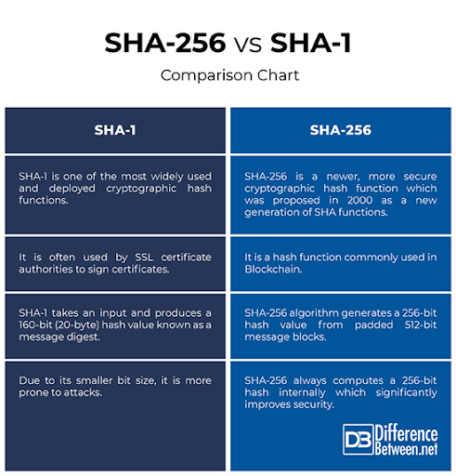
SHA1 Vs SHA256
Notes:
Credits: http://www.differencebetween.net/technology/difference-between-sha-256-and-sha-1/
SSL-secure sockets layer certificate - used to securely access information personally and is encrypted.

Slide 14
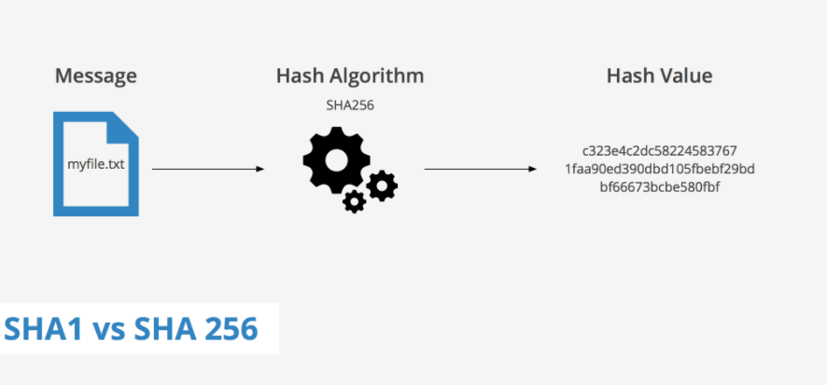
SHA256 is more secure than SHA1!

Slide 15
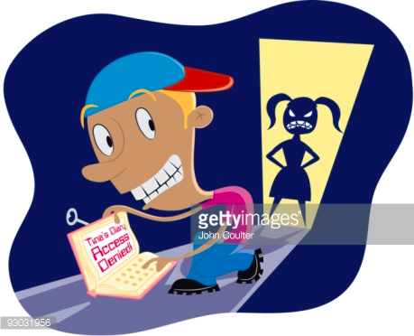
Why Use Hashing?
Hash signature instead of filename
Check if files have the same hash
Can check for copies of files that look the same but might be different
Maybe when solving a murder mystery?
Hashing is an ideal way to store passwords,
as hashes are inherently one-way in their nature.
By storing passwords in hash format, it's very difficult for someone with access to the raw data to reverse it.
Notes:
Using the hash instead of filename can help hide what the file is (say like your diary from your younger brother)
Check if two files have the same hash when being sent something (make sure malware doesn’t get attached)
Photo Credit: http://www.gettyimages.com/detail/illustration/boy-trying-to-read-his-sisters-diary-stock-graphic/93031956?esource=SEO_GIS_CDN_Redirect

Slide 16

Hashing passwords? How? What? Where?
When storing a password:
Hash it with a salt
With any future login attempts, hash the password the user enters and compare it with the stored hash.
If the two match up, then it's virtually certain that the user entering the password entered the right one.
Notes:
A cryptographic salt is made up of random bits added to each password instance before its hashing. Salts create unique passwords even in the instance of two users choosing the same passwords. Salts help us mitigate hash table attacks by forcing attackers to re-compute them using the salts for each user.

Slide 17
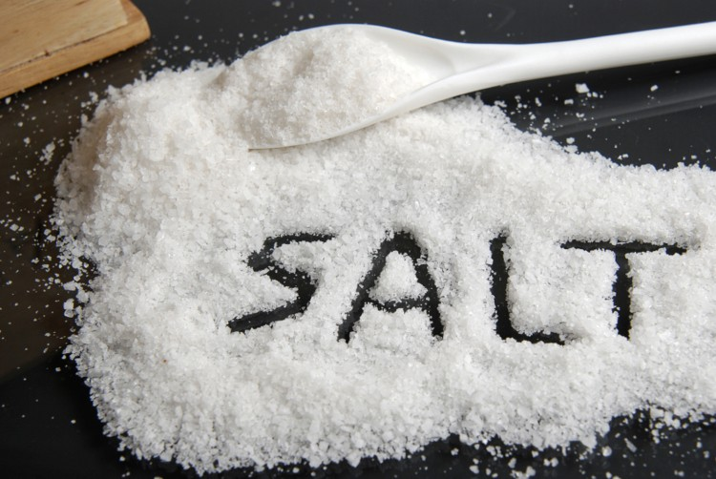
Password Salts
Adding random data, usually 12 bits to the input of a hash function to guarantee a unique output, Consequently, the unique hash produced by adding the salt can protect us against different attack vectors, and slowing down dictionary and brute-force attacks.

Slide 18

Question 1: Can Hashes Be the Same?
Yes, they can, what is this called?
There are only so many possible combinations so some hashes must be the same, right?

Slide 19

Let’s watch a video now on birthday paradox !!!

Slide 20
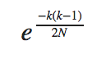
What is the probability of collisions?
Let:
N = number of hashes
k = randomly generated integers
E ≈ 2.71828
In other words:
Very small!

Slide 21
Can Hashes be decoded/broken?
YES! Some can be!
Weak hashing algorithms like MD5 and SHA1 can be broken by generating a “brute force” list of well known passwords and their corresponding hashes also called Rainbow Tables. You can also consider this a form of a wordlist.
Eg: If I know someone would use “pizza” as their password, I could easily find the hash for pizza!
We will be doing this tomorrow!
Notes:
A rainbow table is a precomputed table for caching the output of cryptographic hash functions, usually for cracking password hashes. Tables are usually used in recovering a key derivation function (or credit card numbers, etc.) up to a certain length consisting of a limited set of characters. It is a practical example of a space–time tradeoff, using less computer processing time and more storage than a brute-force attack which calculates a hash on every attempt

Slide 22
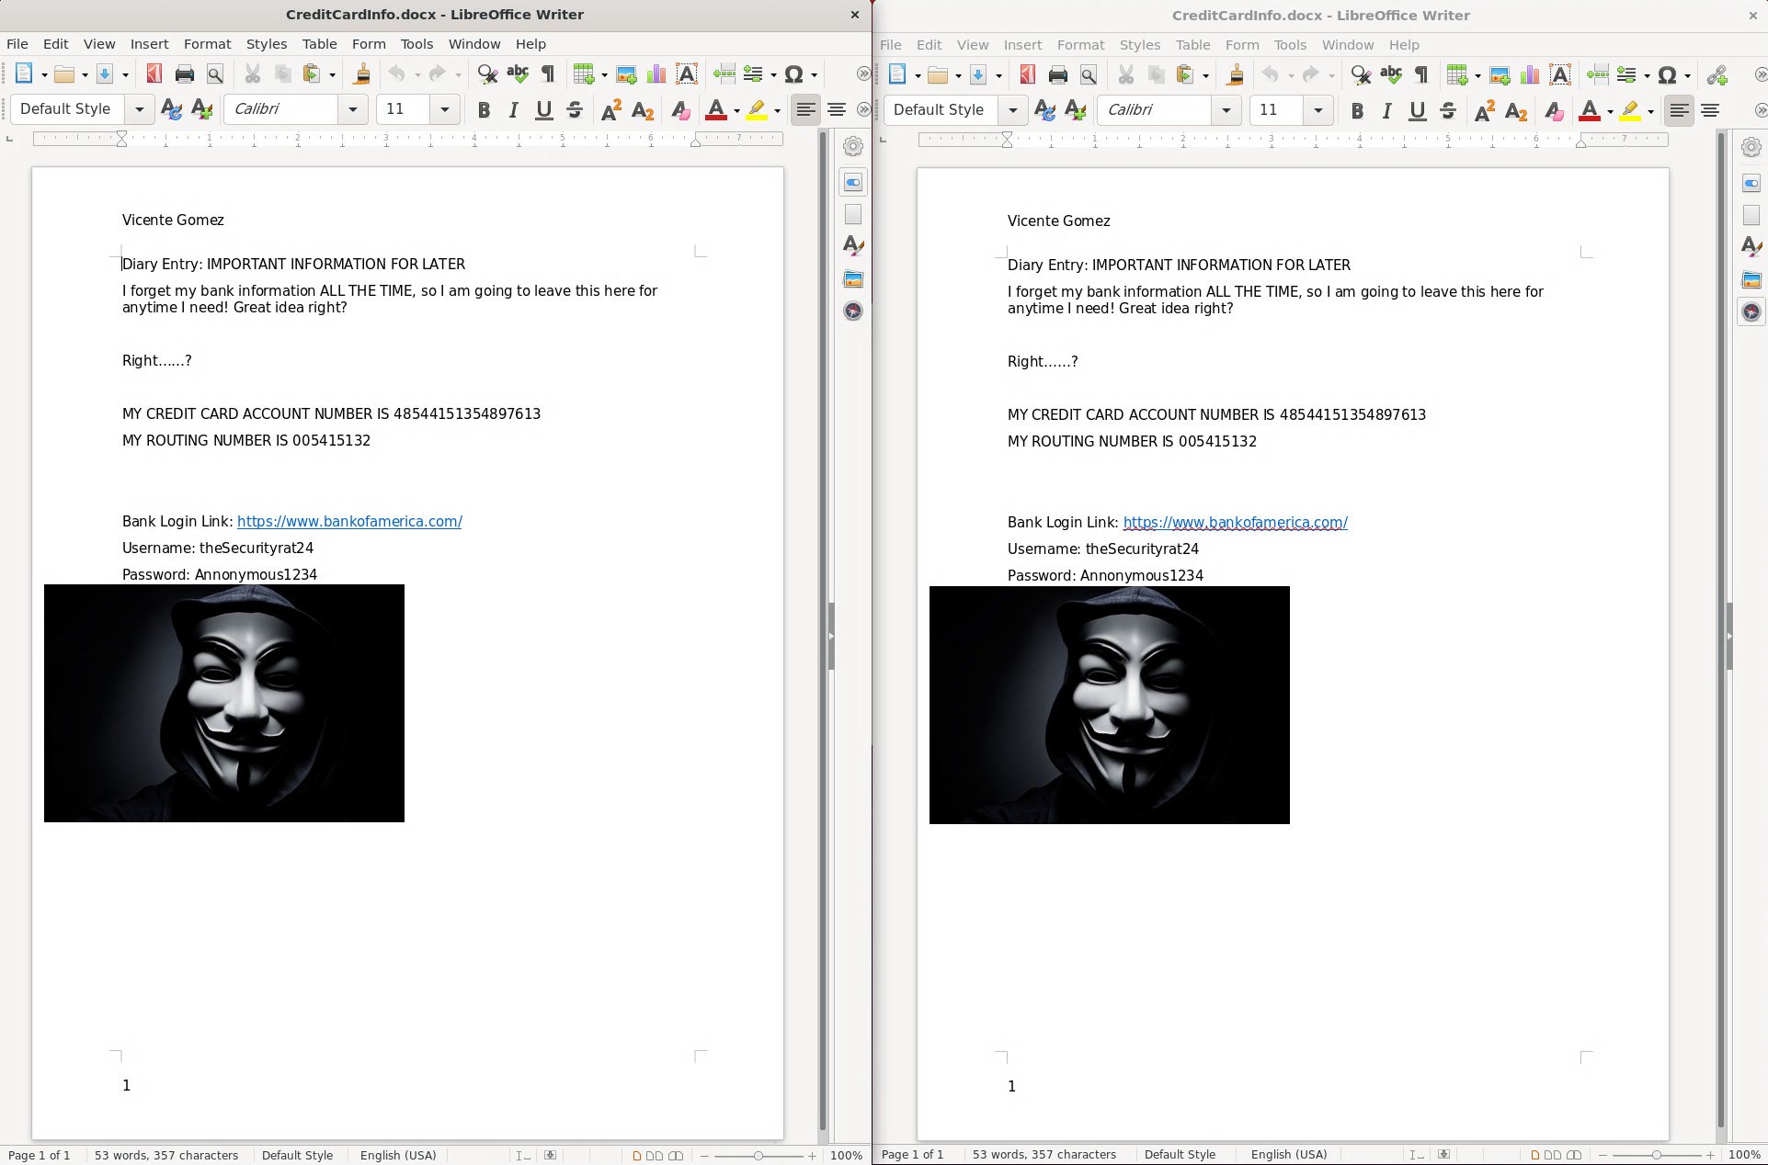
Practice
We are going to be testing files and checking their hash.
Take a look at these files, do you see a difference?
Notes:
https://security.stackexchange.com/questions/189000/how-to-verify-the-checksum-of-a-downloaded-file-pgp-sha-etc

Slide 23
Nope!
On the surface level, this is the exact same document -- the document name, content, font, etc. However, when we dive into the hash of each individual file, there is a significant difference. Test this out yourself!
Download these two files on your FastX VM (make sure you same each of them in a separate location to ensure they have the same name):
File One: https://drive.google.com/file/d/1E7UycT9QmV03J7-L7yga16b9ZiVRXx7n/view?usp=sharing
File Two: https://drive.google.com/file/d/1NHoAJrxo5qhN2B4GPeg3QfQWgf-R0Ksf/view?usp=sharing

Slide 24
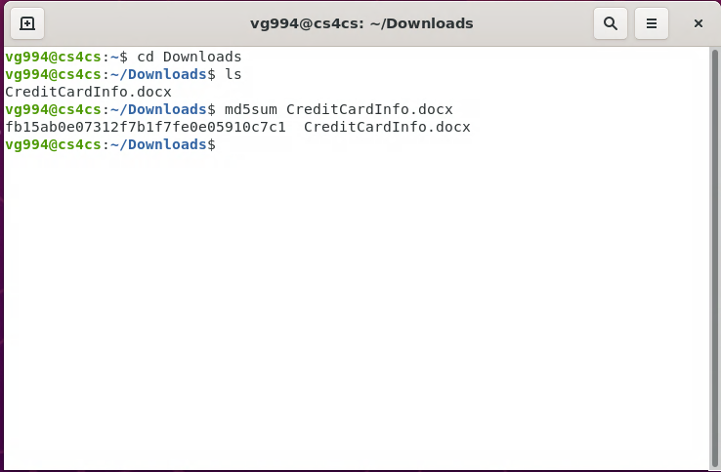
Practice (cont.)
In this example, I have file #1 downloaded in my ‘Downloads’ folder and file #2 in my ‘Documents’ folder. Open the terminal and navigate to file #1’s location:
Step 1: Type ‘cd Downloads’
Step 2: Type ‘ls’ to ensure file is there.
Step 3: Type ‘md5sum CreditCardInfo.docx’ to find the md5 hash signature of file #1.
The md5 hash for File #1 is:
fb15ab0e07312f7b1f7fe0e05910c7c1

Slide 25
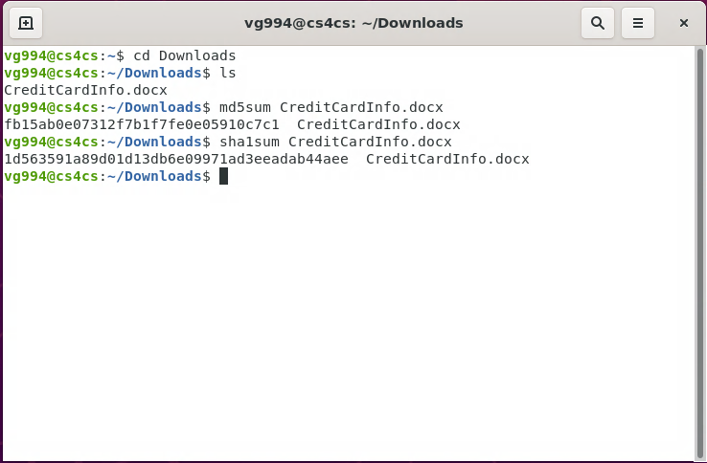
Practice (cont.)
We can check the SHA-1 hash for file 1 as well. Following the same steps as the previous slide, type ‘sha1sum CreditCardInfo.docx’:
The SHA-1 hash for File #1 is:
1d563591a89d01d13db6e09971ad3eeadab44aee

Slide 26
Practice (cont.)
Now we are going to test File #2. These hashes SHOULD NOT be the same, no matter if they have the same content. They are different files.
Is this the case?
Step 1: Type ‘cd ..’ to go back to the home directory
Step 2: Navigate to the location of file #2 by typing ‘cd Documents’
Follow the same steps as the slide before to find the the MD5 and SHA-1 hashes of File #2. Are they the same as File #1?

Slide 27
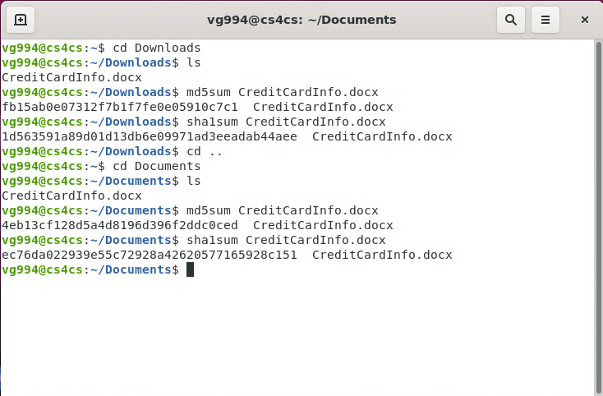

Slide 28
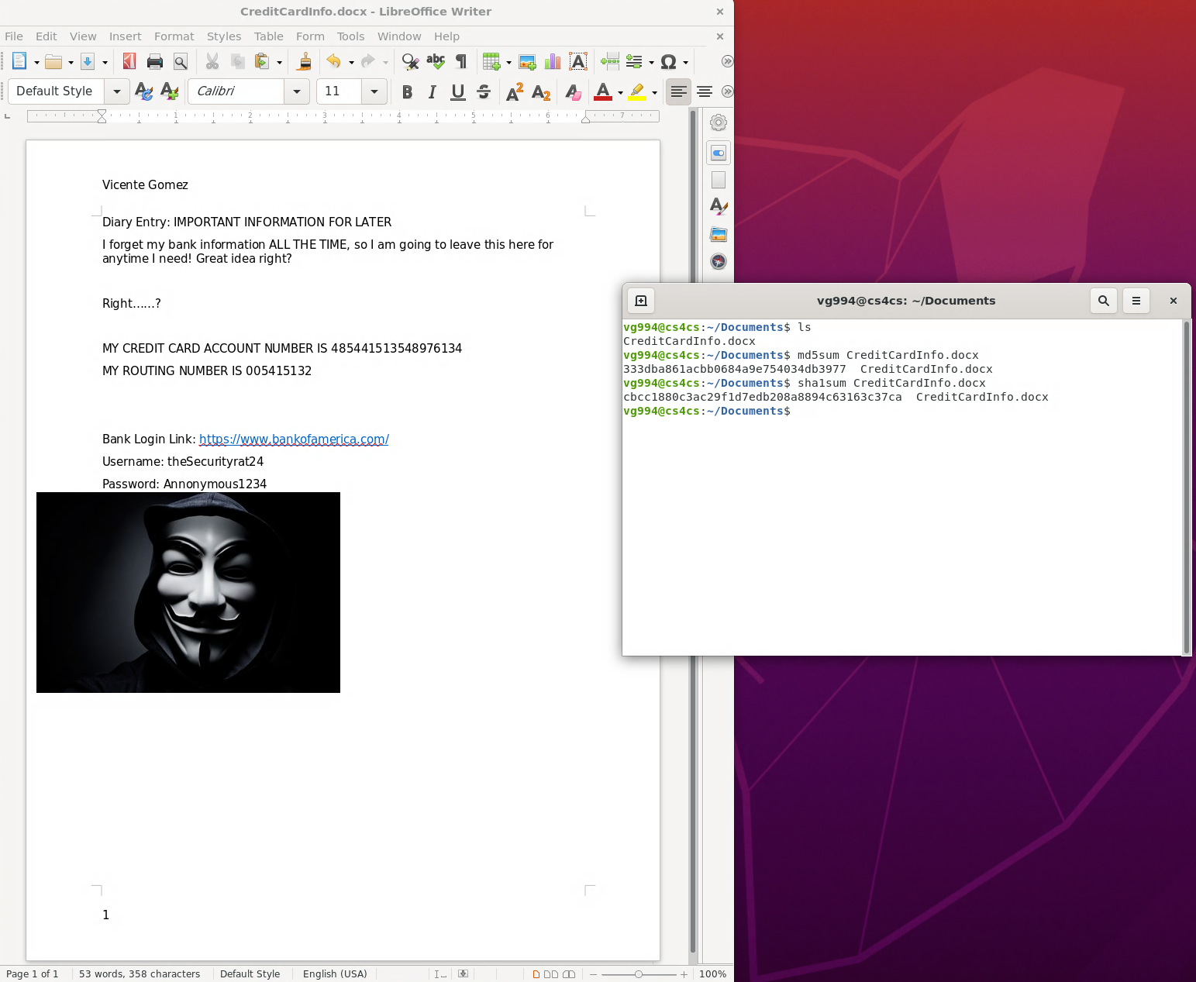
THEY ARE NOT!
Try to do this now. Change one singular aspect of each documents.
Take away a letter, add a letter, add anything! The hash should change ENTIRELY. In the example below, I added a ‘4’ to the account number. You try it now.

